Slide 1
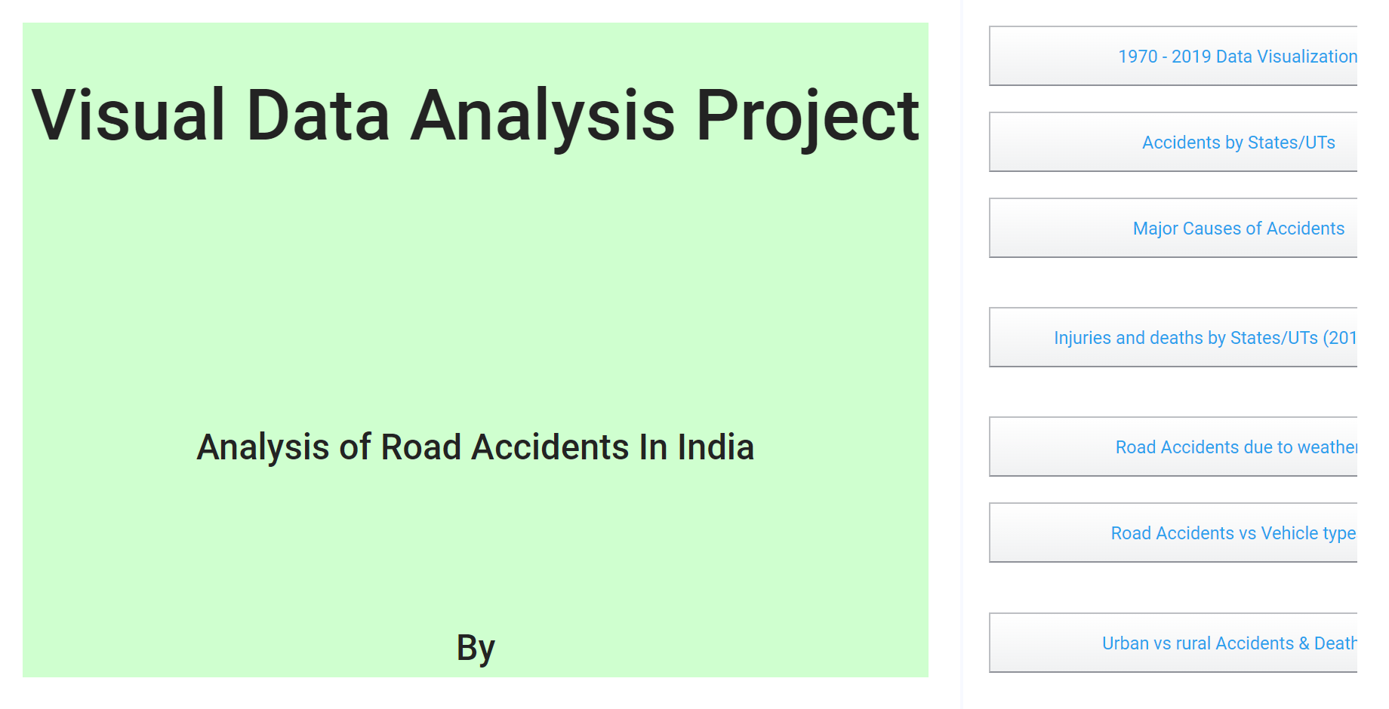
VDA Project

Slide 2
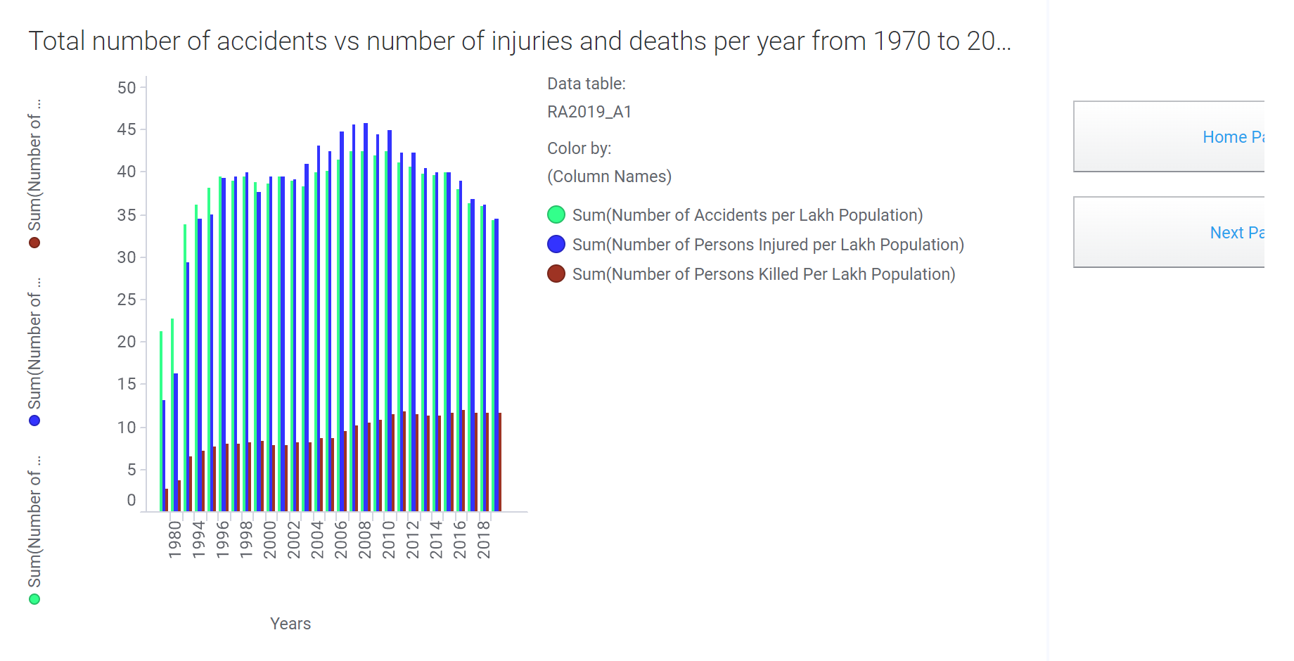
1970 - 2019

Slide 3
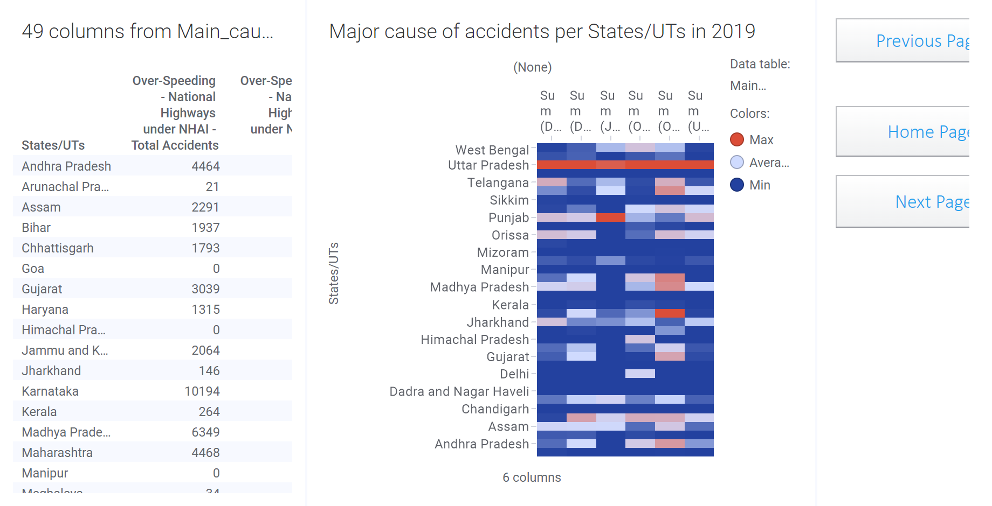
States mostly effected

Slide 4
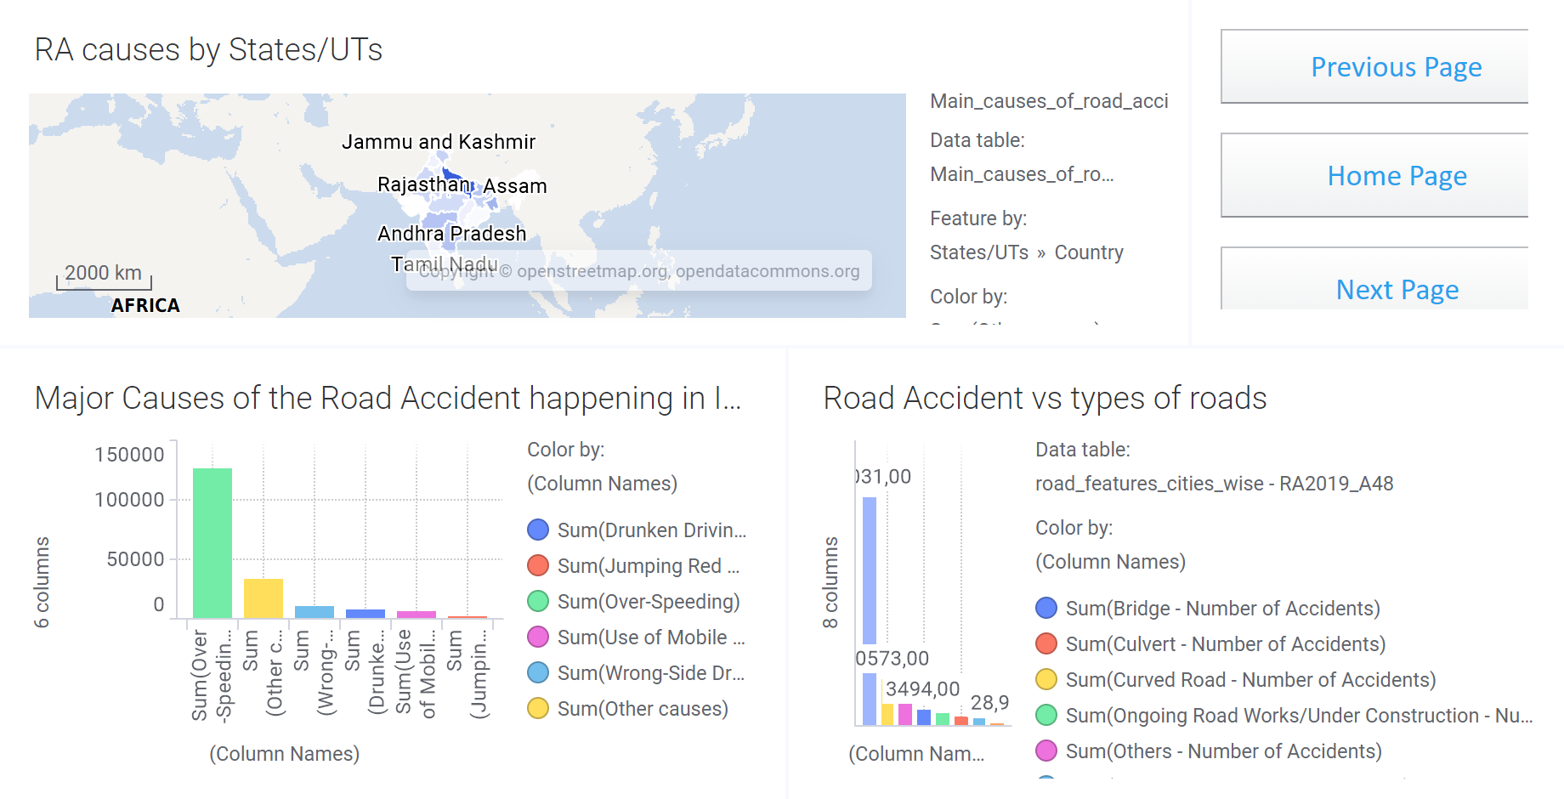
Major causes of accidents

Slide 5
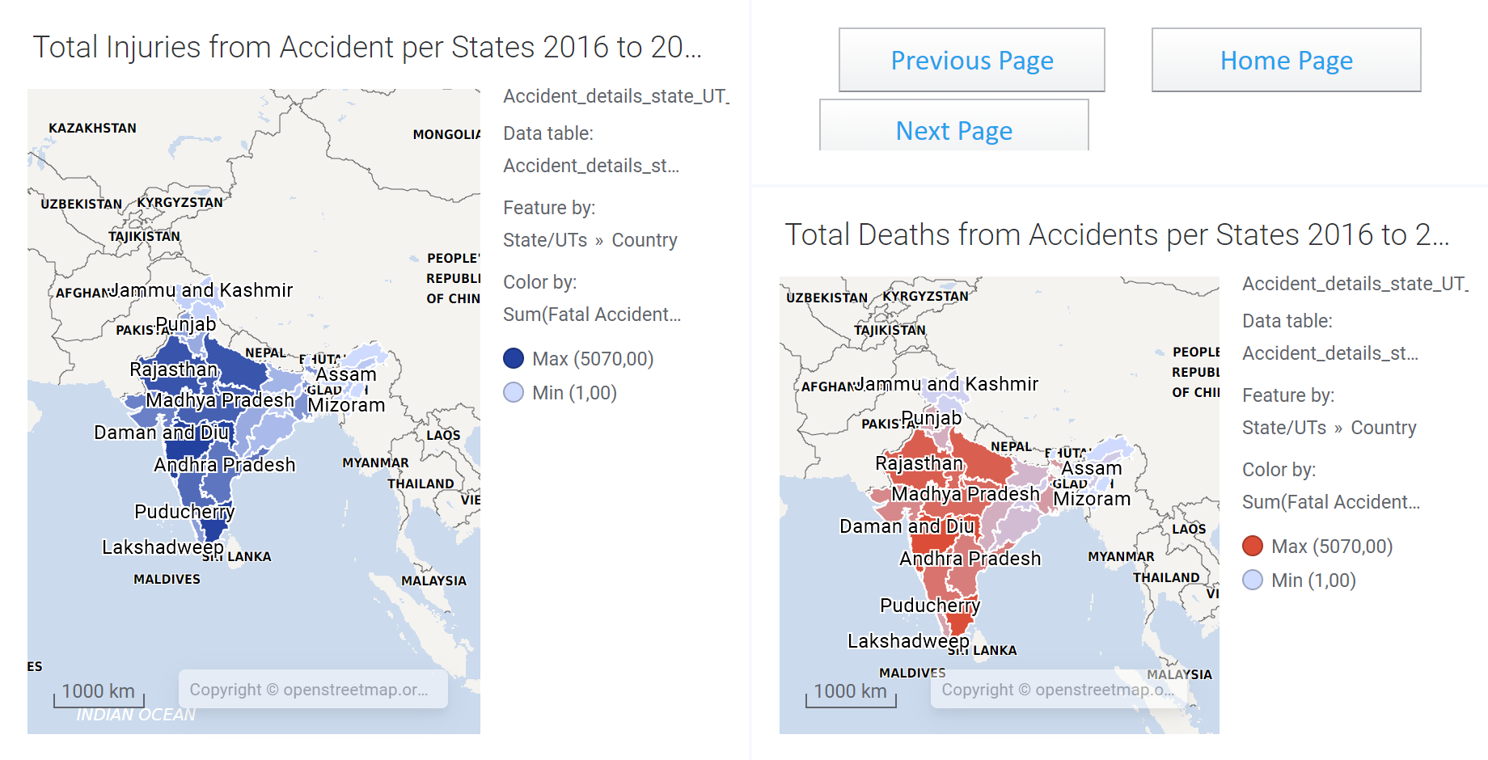
Total Injuries and Deaths per States

Slide 6
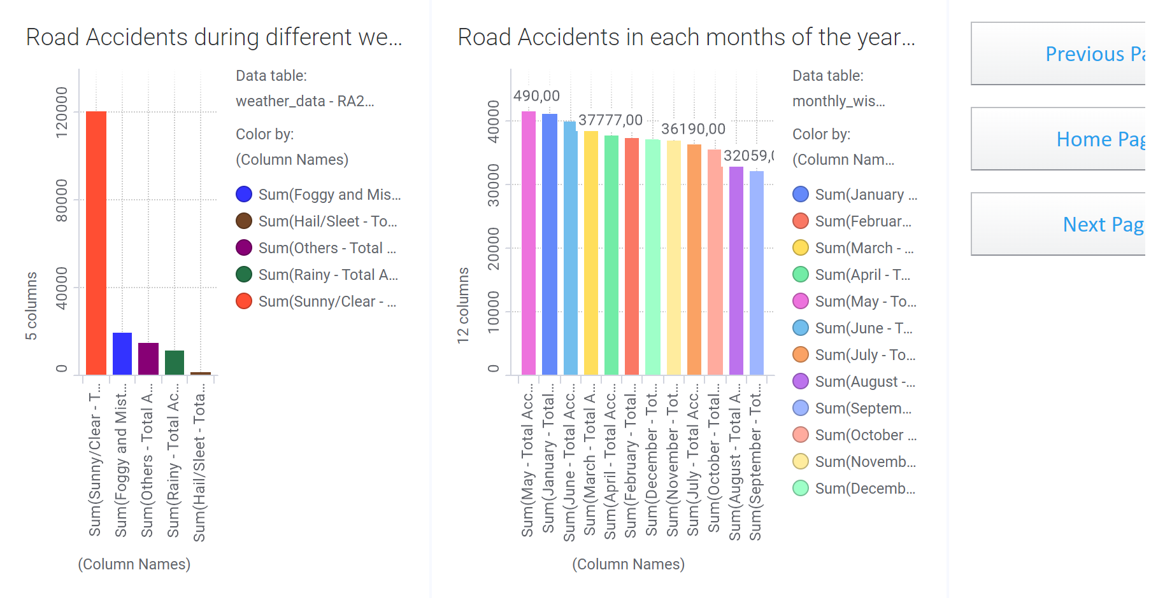
road accident vs weather

Slide 7
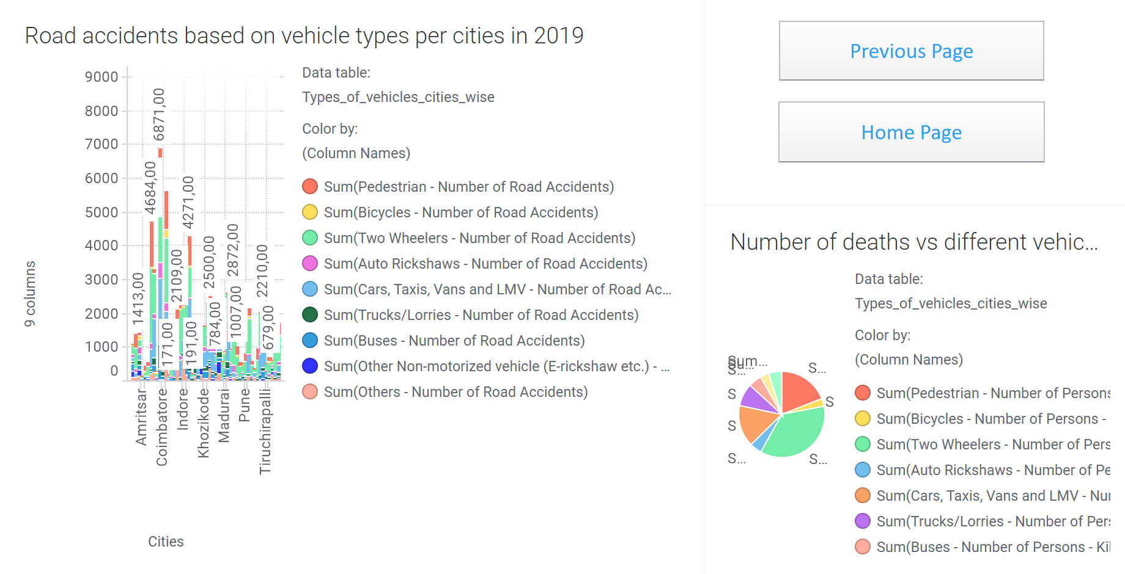
Vehicle types

Slide 8
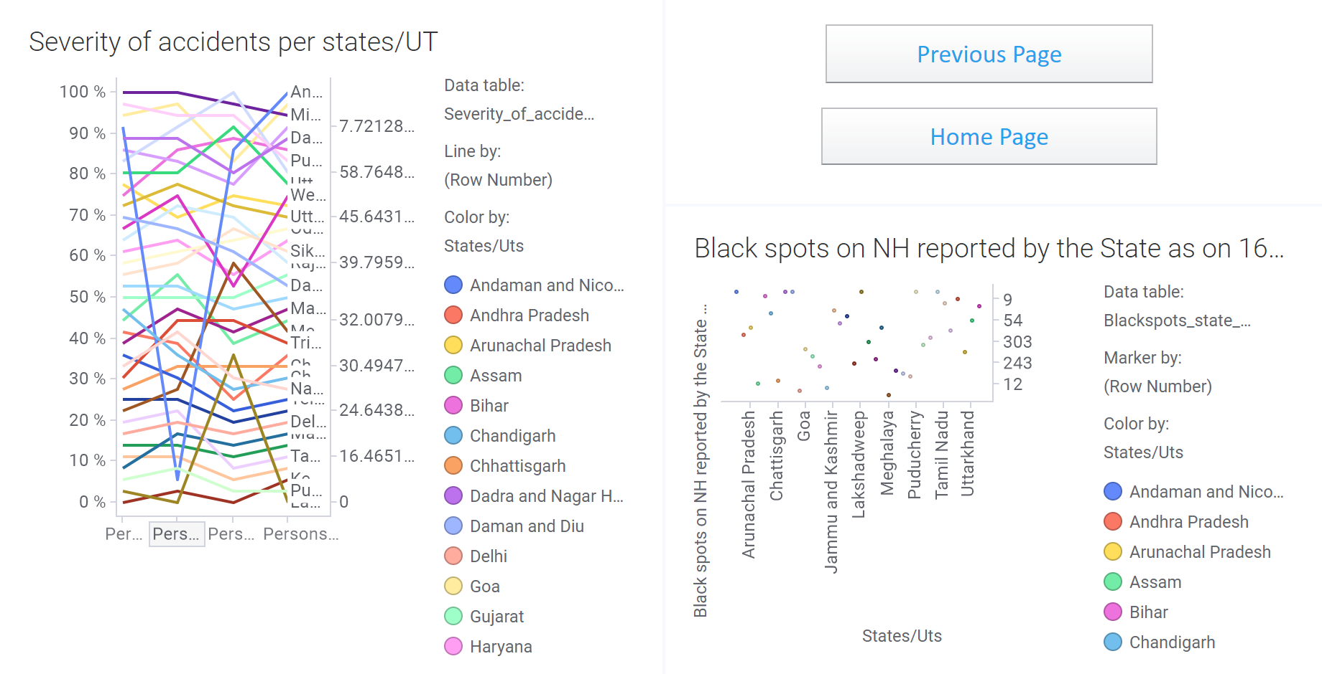
Severity-of-accidents

Slide 9
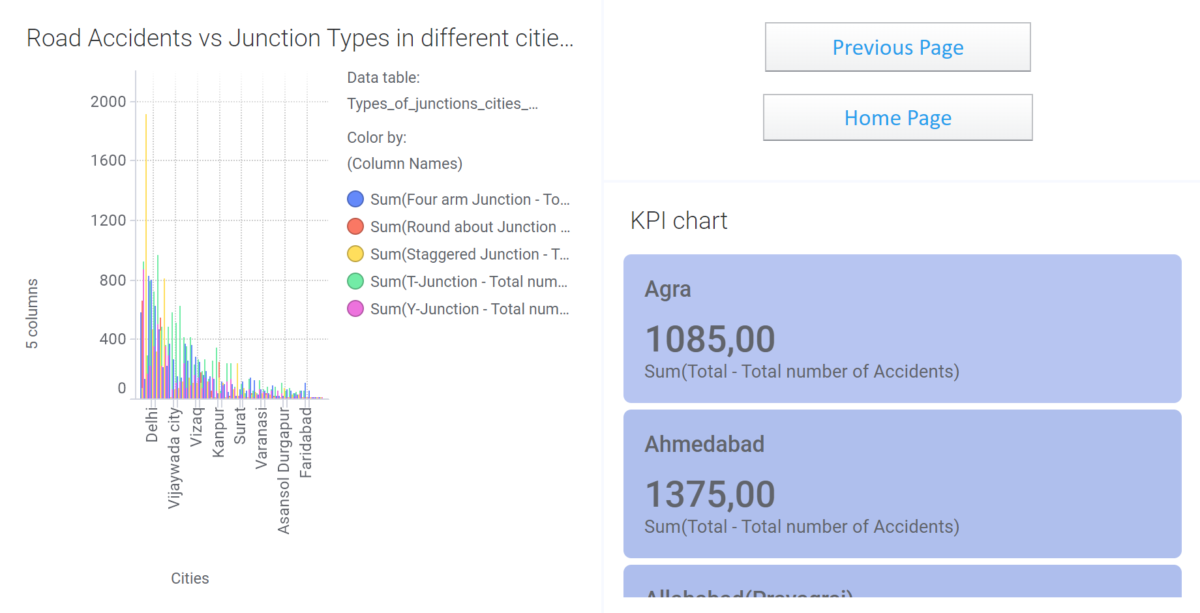
junction_types_per_cities

Slide 10
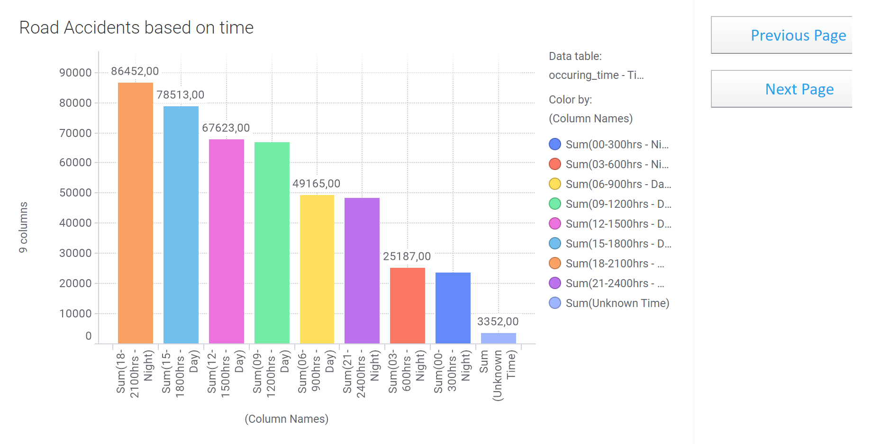
time of the day

Slide 11
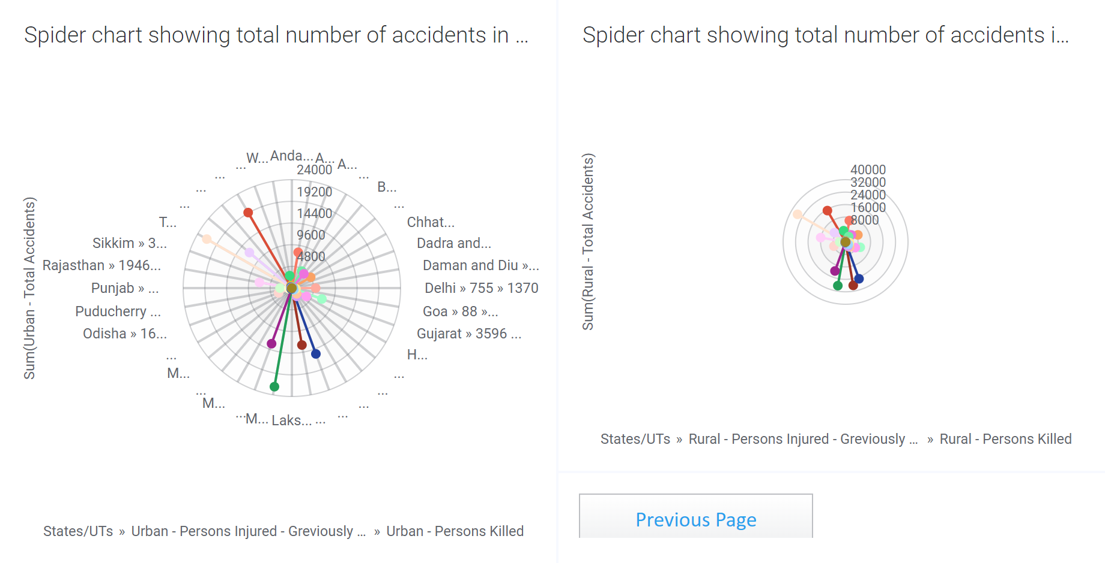
Deaths in urban and rural areas

Slide 12
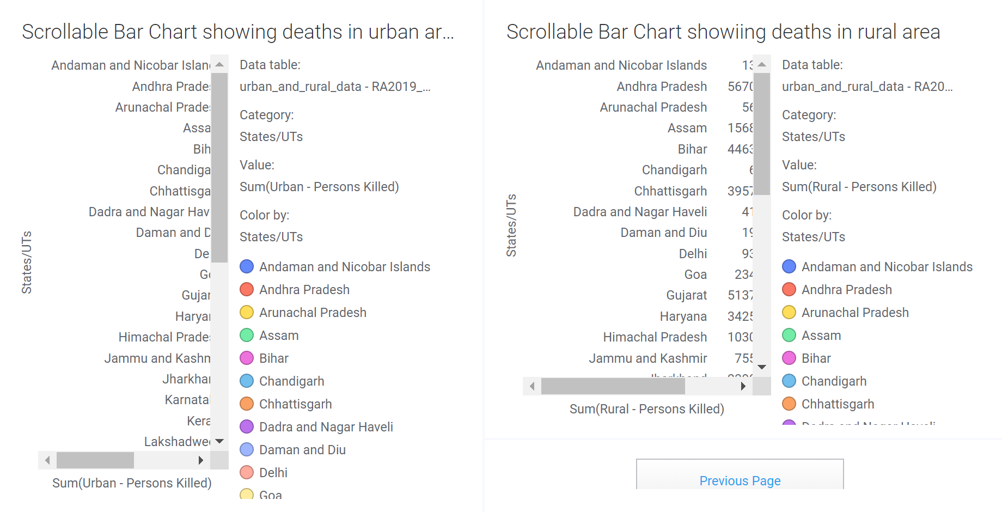
Death counts in urban and rural areas

Slide 13
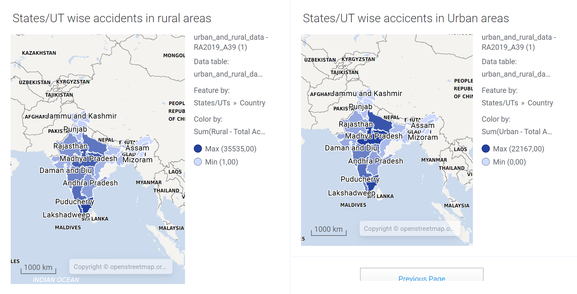
map-chart-rural-and-urban

Slide 14
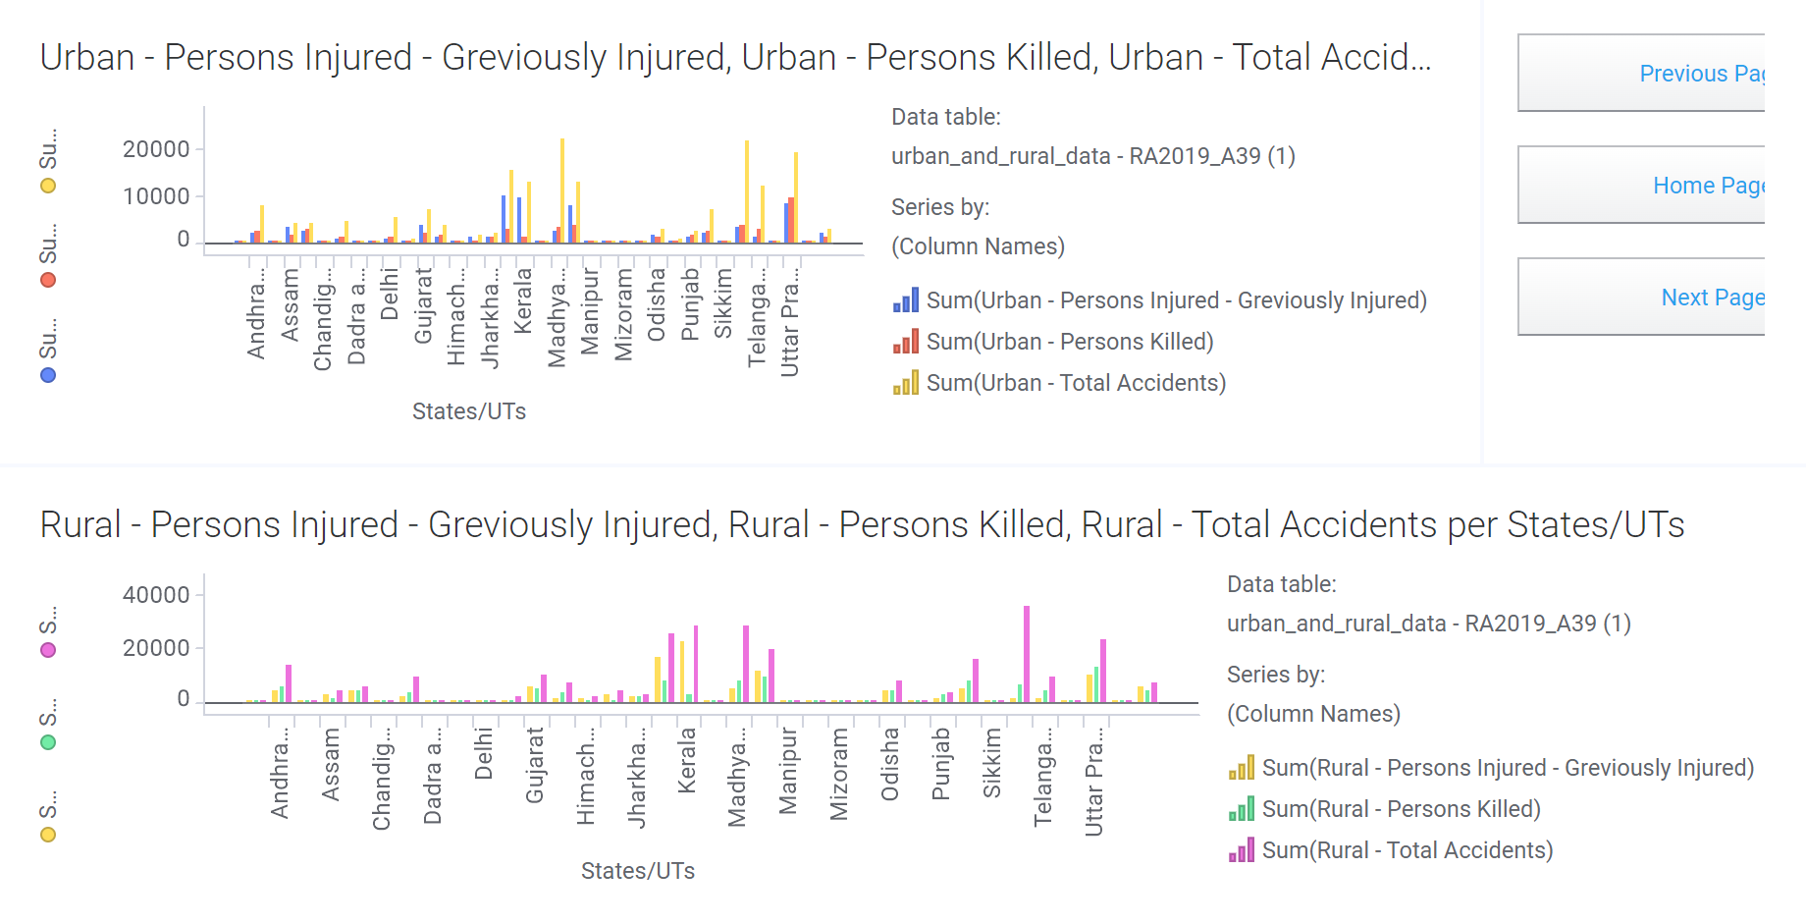
Greviously injured vs deaths in states/UT in urban and rural areas

Slide 15
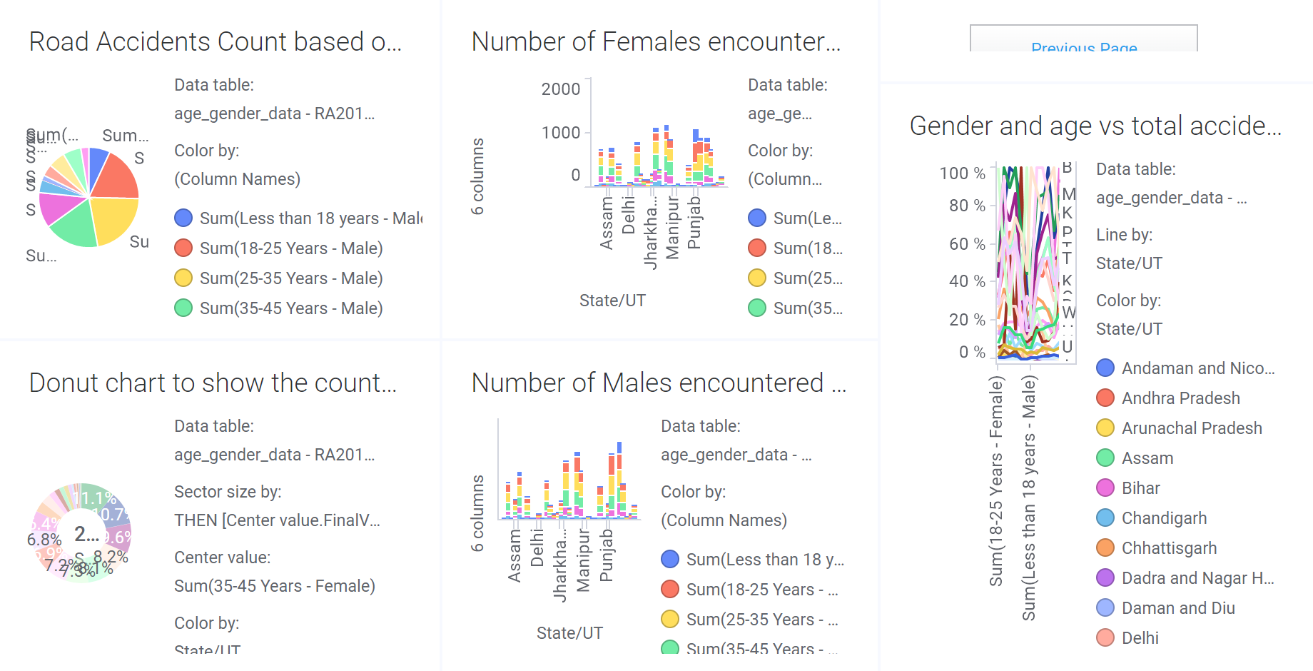
Gender-wise accidents

